Slide 1



TEAM MEMBERS: Anand Pandey (B220072EE) Dibyajit Das Gupta (B220013CS) Debanjana Sur (B220011CS) Nirankush Bharadwaj (B220110CE)
NATIONAL INSTITUTE OF TECHNOLOGY SIKKIM

Slide 2
AI-powered Renewable Energy Integration
Our idea of innovation revolves around using AI to help utilities and power grids integrate renewable energy sources into the grid more effectively.

Slide 3
Introduction
Renewable energy is a hot topic these days. There is a surge in the demand and need to shift towards renewable energy from the conventional sources of energy. But the energy produced is also not being used up to the mark.
Our innovation mainly aims at controlling the losses occurring in the overall consumption process of renewable energy and to develop a machine that centers on an AI model that can interpret the working principle along with training the AI efficiently to reduce the power losses.

Slide 4
Current flaws of Renewable energy generation
Intermittency and Variability: renewable energy sources fluctuate according to the time of day and the weather, making a steady supply of power difficult to achieve.
Resource dependence: Geographical differences affect where renewable resources are available. Solar and wind energy are more advantageous in areas with plentiful sunlight and wind resources than in other areas.
Energy conversion losses: Energy conversion processes, such as the transformation of sunlight to electricity in solar panels, are not 100% efficient. Some energy is lost as heat during these conversions, reducing overall efficiency.
Maintenance and reliability: Components can wear out or break down, leading to energy losses during downtime.

Slide 5
How can our innovation help to overcome the flaws?
It will help to collect data about the various weather conditions and accordingly determine the required power distribution to the consumer from the previous energy stored .
It will determine the output by observing and monitoring the behaviour of the consumer to which the power grid will adjust itself .
It can also help to predict further usages of power through ML and past data and store that excess power beforehand.
Excess power can be used to supply when there is absence of renewable energy.
Prevention of various cases such as loadshedding.

Slide 6
How our innovation will help battle these complications :
It makes near to accurate predictions helping to reduce power loss.
Cheaper in price
Will first dry run by installing it in a working power grid
Works on real time data and takes decisions according to it helping to save power

Slide 7
Steps to Implement AI-powered Renewable Energy Integration
01
02
03
04
05
Train the AI model using the collected data.
Collect data on renewable energy output, weather conditions, and grid operations.
Choose an AI algorithm suitable for the utility's needs.
Monitor and evaluate the AI model's performance.
Monitor and evaluate the AI model's performance.

Slide 8
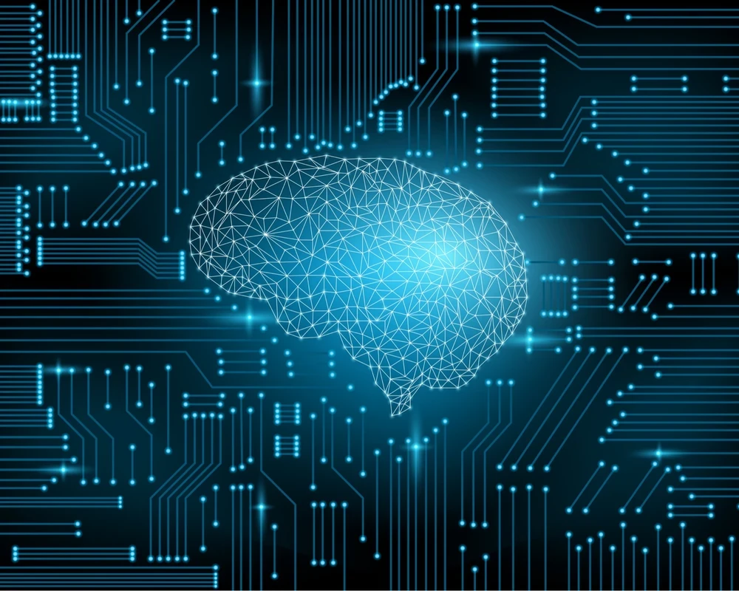
Collect Data
Collect data from renewable energy sources, weather stations, and smart grid sensors.

Slide 9
Choose an AI Algorithm
Consider algorithms like support vector machines, random forests, and deep learning algorithms.
Support vector machines (SVMs) are a type of machine learning algorithm that can be used for classification and regression tasks. SVMs are well-suited for renewable energy integration because they are able to handle noisy and incomplete data.
Deep learning algorithms are a type of machine learning algorithm that uses artificial neural networks to learn from data. Deep learning algorithms are well-suited for renewable energy integration because they can learn complex relationships between data points.

Slide 10
Train the AI Model
01
02
Allow the AI model to learn the relationships between data points.
Feed the
collected
data to the AI model.

Slide 11


Deploy the AI Model
Integrate the AI model into the existing grid management system.

Slide 12


Monitor and Evaluate
Phase 1
Phase 2
Compare AI model's predictions with actual renewable energy output and grid conditions.
Make adjustments as needed.

Slide 13
Conclusion
1
AI-powered renewable energy integration can improve the reliability of the grid.
2
Further research and development are ongoing in this field.

Slide 14
References
Sources of content: Wikipedia
Google scholar
World future energy summit
Sources of picture: Shutterstock

Slide 15
Thank you for your time

Slide 16
Any Questions?

